Slide 1
NNFL Term Project Presentation
Akash Venkatesan 2018A3PS1106P
Shreyas Bhat Kera 2018A7PS1119P
N Harishchandra Prasad 2018A3PS0422P
Paper ID 13

Slide 2
Unpaired Image-to-Image Translation using Cycle-Consistent Adversarial Networks
Authors
Jun-Yan Zhu , Taesung Park , Phillip Isola , Alexei A. Efros
Affiliation
Berkeley AI Research (BAIR) laboratory, UC Berkeley

Slide 3
Aim
CycleGAN is an approach to learning how to translate an image from a source domain X to a target domain Y in the absence of paired examples
The aim is to learn a mapping G : X → Y such that the distribution of images from G(X) is indistinguishable from the distribution Y using an adversarial loss
CycleGAN aims to present qualitative results on several tasks where paired training data does not exist, including collection style transfer, object transfiguration, season transfer, photo enhancement, etc.
The aim of this assignment is to
Train the model on the Van Gogh style transfer dataset
Plot the graph of the training losses across all epochs
Apply the model to other painting datasets such as Monet and Cezanne and show visual results

Slide 4
Methodology
Let us say that we are given one set of images in domain X and another set in domain Y.
We train a mapping,
G : X → Y
such that the output,
ŷ = G(x), x ∈ X,
is indistinguishable from images y ∈ Y by an adversary trained to classify ŷ apart from y.
The optimal G thereby translates the domain X to a domain Ŷ distributed identically to Y .

Slide 5
Methodology(Contd.)
However, such a translation does not guarantee that an individual input x and output y are paired up in a meaningful way – there are infinitely many mappings G that will induce the same distribution over ŷ.
It has been found that it is difficult to optimize the adversarial objective in isolation: standard procedures often lead to the well known problem of mode collapse, where all input images map to the same output image and the optimization fails to make progress .
Therefore, the process aims to exploit the property that translation should be “cycle consistent”.

Slide 6
Methodology(Contd.)
Mathematically, if we have a translator
G : X → Y
and another translator,
F : Y → X,
then G and F should be inverses of each other, and both mappings should be bijections.
CycleGAN applies this structural assumption by training both the mapping G and F simultaneously, and adding a cycle consistency loss that encourages
F(G(x)) ≈ x and G(F(y)) ≈ y.
Combining this loss with adversarial losses on domains X and Y yields the full objective for unpaired image-to-image translation.

Slide 7
Final Outcomes
The method can be applied to a wide range of applications, including collection style transfer, object transfiguration, season transfer and photo enhancement.
Upon comparison against previous approaches that rely either on hand-defined factorizations of style and content, or on shared embedding functions, CycleGAN can outperform these baselines.
In this assignment we show that CycleGAN can be trained on the Van Gogh dataset and can be used as a method of style transfer to convert Real Life images and paintings from Cezanne and Monet to the ‘style’ of Van Gogh. We also show the importance of two important aspects that CycleGAN uses, cycle consistency and identity loss, through visual results.

Slide 8
Background

Slide 9
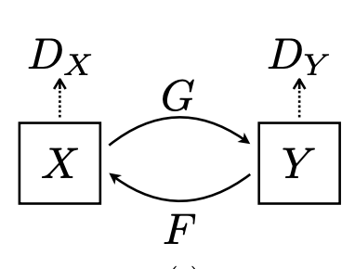
Formulation
The goal is to learn mapping functions between two domains X and Y given training samples
{x_{i}}^{N}_{i=1} where x_{i} ∈ X and {y_{j}}^{M}_{j=1} where y_{j} ∈ Y .
We denote the data distribution as x ∼ p_{data}(x) and y ∼ p_{data}(y).
As illustrated, the model includes two mappings, thus using 2 Generators.
G : X → Y and F : Y → X.

Slide 10
Formulation(Contd.)
In addition, there exists two adversarial discriminators D_{X} and D_{Y} , where D_{X} aims to distinguish between images {x} and translated images {F(y)}; in the same way, D_{Y} aims to discriminate between {y} and {G(x)}.
The objective contains two types of terms:
adversarial losses for matching the distribution of generated images to the data distribution in the target domain
cycle consistency losses to prevent the learned mappings G and F from contradicting each other

Slide 11
Adversarial Loss
An adversarial loss is applied to both mapping functions.
For the mapping function G : X → Y and its discriminator DY , the objective is expressed as:
L_{GAN}(G, DY , X, Y ) = E_{y~pdata}(y) [log D_{Y} (y)] + E_{x~pdata}(x) [log(1 − D_{Y} (G(x))],
where G tries to generate images G(x) that look similar to images from domain Y , while D_{Y} aims to distinguish between translated samples G(x) and real samples y.

Slide 12
Adversarial Loss(Contd.)
G aims to minimize this objective against an adversary D_{y} that tries to maximize it, i.e.,
min_{G} max_{DY} L_{GAN}(G, D_{Y} , X, Y ).
A similar adversarial loss is introduced for the mapping function F : Y → X and its discriminator D_{X} as well: i.e.,
min_{F} max_{DX} L_{GAN}(F, D_{X}, Y, X).

Slide 13
Cycle Consistency Loss
With a large enough capacity, a network can map the same set of input images to any random permutation of images in the target domain, where any of the learned mappings can induce an output distribution that matches the target distribution.
Thus, adversarial losses alone cannot guarantee that the learned function can map an individual input x_{i} to a desired output y_{i} .

Slide 14
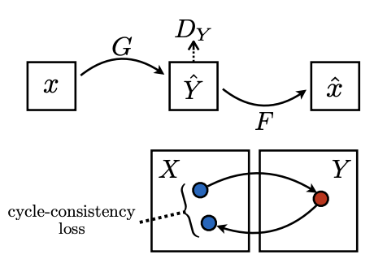
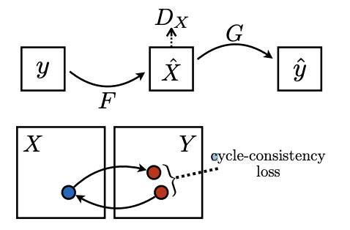
Cycle Consistency Loss
To further reduce the space of possible mapping functions, the learned mapping functions should be cycle-consistent: as shown in the image, for each image x from domain X, the image translation cycle should be able to bring x back to the original image, i.e.,
x → G(x) → F(G(x)) ≈ x.
This is called forward cycle consistency
Similarly, as illustrated in the following figure, for each image y from domain Y , G and F should also satisfy backward cycle consistency:
y → F(y) → G(F(y)) ≈ y.

Slide 15
Cycle Consistency Loss(Overall)
This behaviour is incentivized using a cycle consistency loss:
L_{cyc}(G, F) = E_{x~pdata(x)}[||F(G(x)) − x||₁] + E_{y~pdata(y)} [||G(F(y)) − y||₁].
In preliminary experiments, the authors experimented with replacing the L1 norm in this loss with an adversarial loss between F(G(x)) and x, and between G(F(y)) and y, but did not observe improved performance.
Visual results to show the effect of cycle consistency are given on the Results slides.

Slide 16
The Full Objective Function
The full objective is:
L(G, F, D_{X}, D_{Y} ) =L_{GAN}(G, D_{Y} , X, Y ) + L_{GAN}(F, D_{X}, Y, X) + λL_{cyc}(G, F),
where λ controls the relative importance of the two objectives.
Thus the aim is to solve:
G* , F* = arg min_{G,F} max_{Dx,Dy} L(G, F, D_{X}, D_{Y} ).
It can be noted that the model can be viewed as training two “adversarial autoencoders” : we learn one autoencoder F ◦ G : X → X jointly with another G◦F : Y → Y , where each has a special internal structures: they map an image to itself via an intermediate representation that is a translation of the image into another domain.

Slide 17
Dataset Details

Slide 18
Datasets
The following details are about the datasets (Van Gogh, Cezanne and Monet) that we use in the assignment)
The art images were downloaded from Wikiart.org. Some artworks that were sketches were pruned manually.
The photos (‘real images’) were downloaded from Flickr using the combination of tags ‘landscape’ and ‘landscapephotography’. Black-and-white photos were pruned.
The images were scaled to 256 × 256 pixels.
The vangogh2photo dataset has the following 4 subfolders -
testA - 400 Van Gogh test images
testB - 751 Real test images
trainA - 400 Van Gogh train images
trainB - 6287 Real test images

Slide 19
Datasets (Contd.)
The vangogh2photo included only Van Gogh’s later works that represent his most recognizable artistic style.
The monet2photo dataset has the following 4 subfolders -
testA - 121 Monet test images
testB - 751 Real test images
trainA - 1072 Monet train images
trainB - 6287 Real test images
The Monet dataset was particularly pruned to include only landscape paintings.

Slide 20
Datasets (Contd.)
The cezanne2photo dataset has the following 4 subfolders -
testA - 58 Cezanne test images
testB - 751 Real test images
trainA - 525 Cezanne train images
trainB - 6287 Real test images
Some other datasets that CycleGAN can be trained on include summer2winter, satellite2map, apples2oranges, cityscapes(labels2photo) and horse2zebra, which can be found at the datasets website

Slide 21
Implementation

Slide 22
Implementation Details
The source code, given by the authors is written purely in Python using PyTorch
We add a jupyter notebook (run on Colab) that contains the necessary code to satisfy the aim of our assignment
In particular, we download the dataset, set the appropriate configurations before training, and then train the model from scratch on the Van Gogh Dataset for a total of 200 epochs
After this we test our model to give various results on Real Life images as well as images from the Cezanne and Monet paintings datasets
Note: The description of all the files and functions as well as instructions relevant to implementing the CycleGAN model needed for our assignment can be found in the notebook.

Slide 23
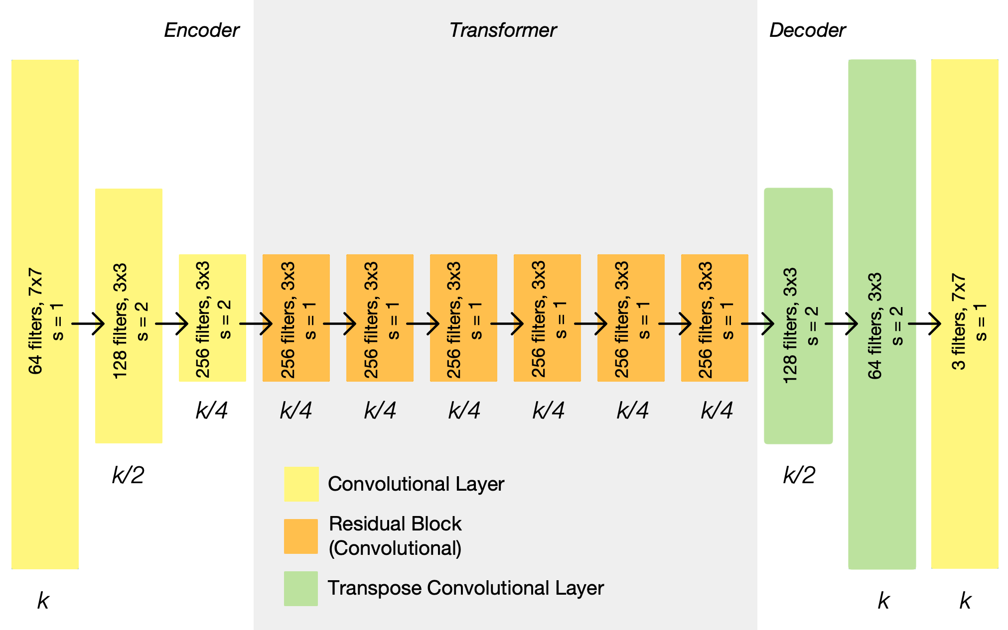
Architecture Details
The generator network is similar to the
image given, but with 9 residual blocks (since image
sizes are 256 x 256).
The discriminator uses 70 x 70 PatchGANs
which aim to classify whether 70 × 70
overlapping image patches are real or fake.
As stated earlier, there are 2 Discriminators and 2
Generators

Slide 24
Training Details
The model was trained on the Van Gogh dataset, with a subset of the Real Life images (400 images).
The model was trained for a total of 200 epochs.
The L_{GAN} loss is replaced with least square loss rather than negative log-likelihood i.e. for L_{GAN}(G, D, X, Y ), we train the G to minimize E_{x}∼p_{data}(x) [(D(G(x)) − 1)² ] and train the D to minimize E_{y}∼p_{data}(y) [(D(y) − 1)² ] + E_{x}∼p_{data}(x) [D(G(x))² ].
The λ in the full objective function is set to 10, batch size is kept at 1, Adam optimizer is used and learning rate is kept at 0.0002 for the first 100 epochs then linearly reduced to 0 over the last 100 epochs.
As specified by the paper, for the Van Gogh dataset, we introduce another loss component, identity loss given by L_{identity}(G, F) = E_{y}∼p_{data}(y) [||G(y) − y||₁] + E_{x}∼p_{data}(x) [||F(x) − x||₁]. This is shown to help preserve color composition between the input and output. The importance of this loss can be seen in the results
Further training details are given in the train_opt.txt file.

Slide 25
Pseudocode for training
Create two generators G_A and G_B, as well as 2 discriminators D_A and D_B.
For every epoch do:
Update learning rate if required
Collect a minibatch of samples from Domain X (Van Gogh Paintings) [batchsize was fixed at 1 for our trials]
Collect a minibatch of samples from Domain Y (Real Life Images)
Calculate the losses for generators G_A and G_B
Calculate the identity loss
Calculate forward and backward cycle losses
Compute the gradients and update weights for the generators
Calculate the losses for discriminators D_A and D_B
Compute the gradients and update weights for the discriminators.

Slide 26
Results

Slide 27
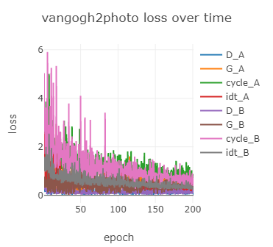
Results of training
As mentioned earlier, the model was trained for 200 epochs.
The labels are:
D_A - Discriminator A loss
G_A - Generator A loss
cycle_A - forward cycle loss
idt_A - identity loss A
D_B - Discriminator B loss
G_B - Generator B loss
cycle_B - backward cycle loss
idt_B - identity loss B
As seen from the graph, the linear decrease of learning rate
after 100 epochs helps stabilize the loss values

Slide 28
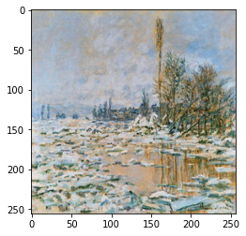
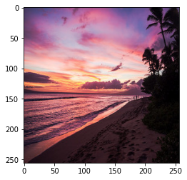
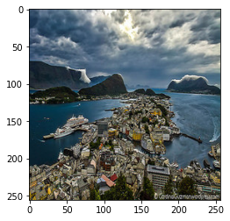
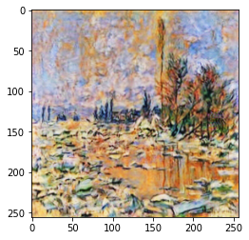
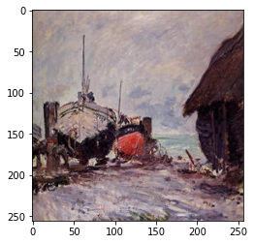
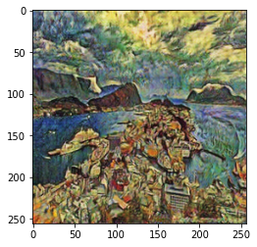
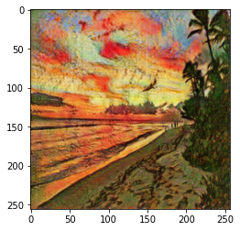
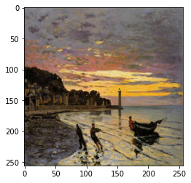
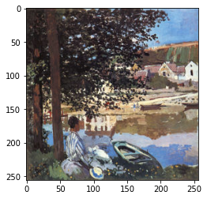
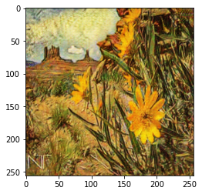
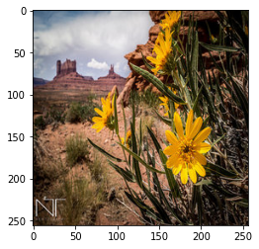
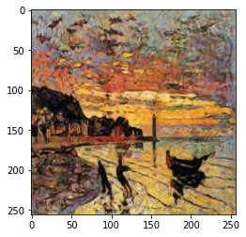
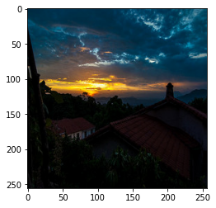
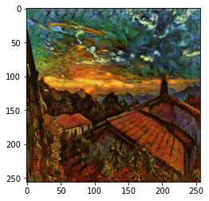
Visual Results - transformations on Real Life Images

Slide 29
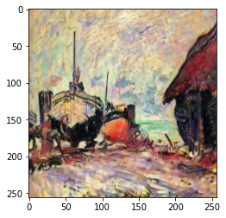
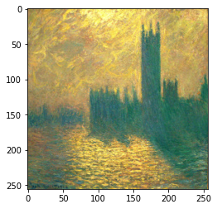
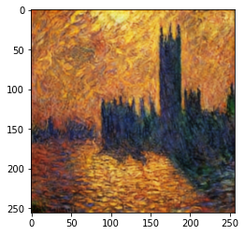
Visual Results - transformations on Monet paintings

Slide 30
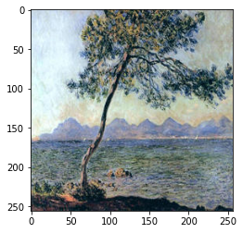
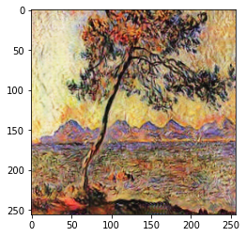
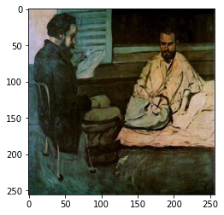
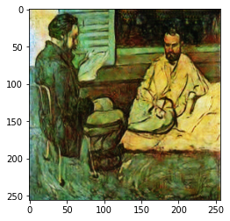
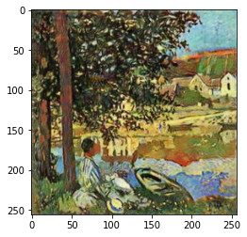
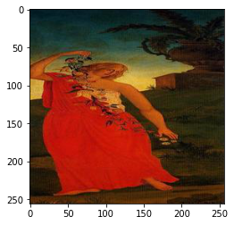
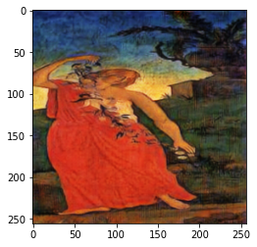
Visual Results - transformations on Cezanne paintings

Slide 31
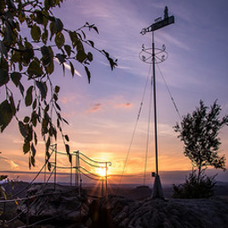
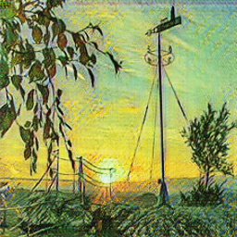
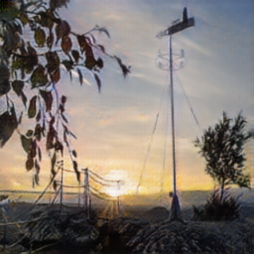
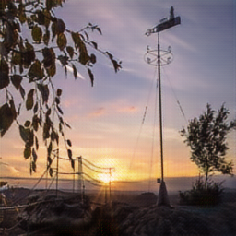
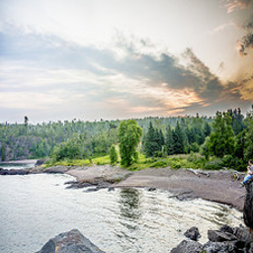
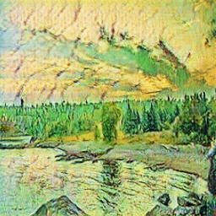
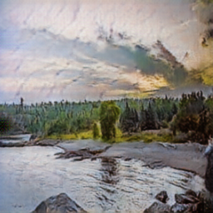
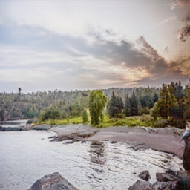
Visual Results - Demonstrates effectivity of both cycle loss and identity loss
Original Image | Van Gogh transformation | Reconstructed Image, using second generator | Reconstructed Image with Identity Loss, preserves color

Slide 32
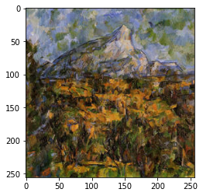
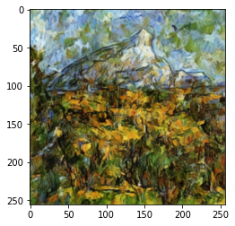
Challenges Faced
Time was a factor as we were unable to train the full dataset due to epoch training times being very large.(One epoch took around 1 hour to train, therefore 200 epochs would take more than a week)
FCN scores were difficult to achieve as the required caffe model for the cityscapes dataset was quite large and would not fit into memory.
A few images did not give realistic transformations due to image inconsistencies or similar nature between the input and output domains.
No significant change on this Cezanne painting to ‘Van Gogh ’ style

Slide 33
Challenges Faced
Understanding the complete theory, architecture as well as the relevant loss functions needed for its performance was a challenge that needed to be tackled in order to get the visual results we produced
Understanding the source code as well as implementing its functions took time and patience, in order to get the appropriate model ready to train and test.

Slide 34
Future Scope
Image translation using CycleGAN can be used to convert grayscale images to B&W images, change someone’s age/gender in images, etc. Image translation has several applications in the fields of art, medical field, videos, and video games.
We can extend this model to video translation by performing image translation on each frame of a video.
CycleGANs can also be used in the domains of music, language etc. For example, they can be used to translate words, phrases, sentences etc from one language to another.
Attempts can been made to make CycleGAN more accurate, in terms of better generalization capabilities (since the model tends to fail when there are images outside the scope of the dataset it was trained on), as well as improved performance on geometric tasks (ex. Cats -> Dogs), since these are some limitations of CycleGAN
Attempts have been made to further streamline and increase efficiency of CycleGAN

Slide 35
Experience and Learning Outcomes
The main learning experience was learning about the breakthrough model of CycleGAN along with its various applications, which have great modern day impacts
Being able to read and effectively interpret research papers, in order to implement the models and reproduce results was another beneficial outcome
We learnt further details about using Python, and particularly the PyTorch framework to create, train and test these models. We also learnt the use of the Python library visdom to visualize results in an effective manner.
We learnt to efficiently use the GPU capabilities provided by Google Colab for training our models
The experience of going through online repositories of machine learning and deep learning models with various real-life applications, such as style transfer, object transfiguration, photo enhancement, etc shed light on the vast potential implications that research in these fields can have

Slide 36
Thank You

